Slide 1
Test-Driven Development (and more refactoring)
CMSC 360 Software Engineering
Dr. Jason B. Shepherd

Slide 2
Quotes from past semesters
“[Student name] broke [feature 1] when coding [feature 2].”
“The problem is the error happens over here in the code, but we don’t detect and handle the error until over here.”
“The signature for [function name] has three arguments, but the third argument is no longer matters like it did when we coded [feature 1]. We should probably get rid of it… some time… eventually….”
“Our branch is polluted with commits that have broken code, because we didn’t run all the different possible test cases to check to see if we broke anything. It just takes too much time.”

Slide 3
Test-driven development (TDD)
Tests call functions and verify…
… correct operation
… correct failure
Write tests first
Before writing the code the tests test
Seems backwards
Tests incentivize good clean interfaces and modular design

Slide 4
Unit tests
Test individual functions
Test individual use cases
Base cases
Edge cases
Error cases
Unit tests are aggregated into module-level/package-level tests
A test runner runs all your unit tests
Regression testing

Slide 5
Python unit testing
unittest (part of Python Std Lib)
Nose 2
Pytest

Slide 6
Installing Pytest in your project
You:
cd my-project
virtualenv -p python3 env
source env/bin/activate
pip install pytest
pip freeze >requirements.txt
Add this file to your GitHub repo.
Some other dev:
cd my-project
virtualenv -p python3 env
source env/bin/activate
pip install –r requirements.txt

Slide 7
What does a Pytest unit test look like?
funcs.py
def next(i):
return i + 1
def prev(i):
return i # This is a bug.

Slide 8
What does a Pytest unit test look like?
tests.py
from funcs import next, prev
def test_next():
assert next(7) == 8
def test_prev():
assert prev(7) == 6
Run with “pytest tests.py”.
Pytest runs each and every function that starts with “test_”.

Slide 9
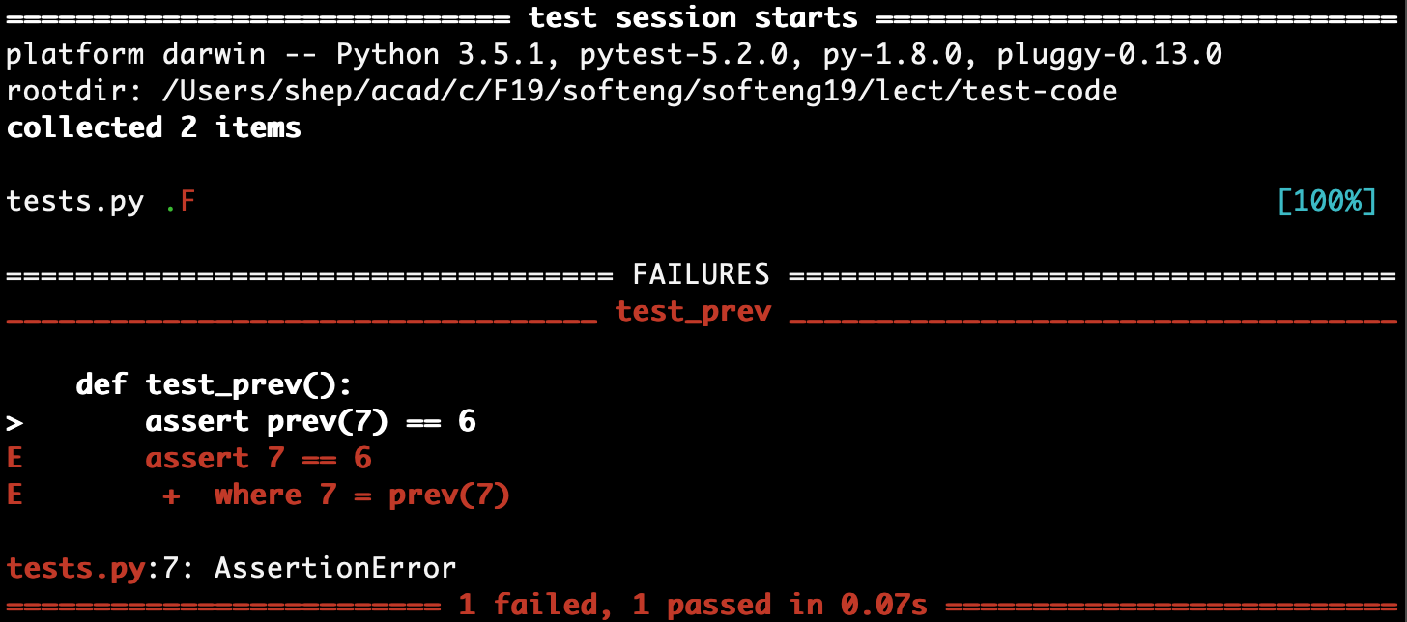
pytest tests.py

Slide 10
What does a Pytest unit test look like?
funcs.py
def next(i):
return i + 1
def prev(i):
return i - 1 # Fixed!

Slide 11
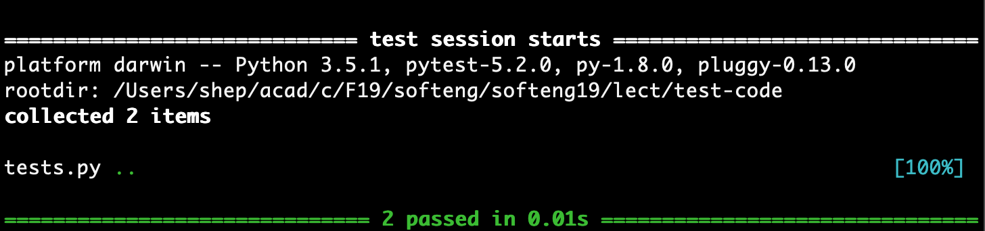
pytest tests.py

Slide 12
Testing exceptional conditions
funcs.py
def next(i):
if type(i) != int:
raise TypeError('{} is not an integer'.format(i))
return i + 1
def prev(i):
if type(i) != int:
raise TypeError('{} is not an integer'.format(i))
return i - 1

Slide 13
Testing exceptional conditions
tests.py
from funcs import next, prev
def test_next():
assert next(7) == 8
def test_prev():
assert prev(7) == 6
def test_fail_next_nonint():
x = next(5.5)

Slide 14
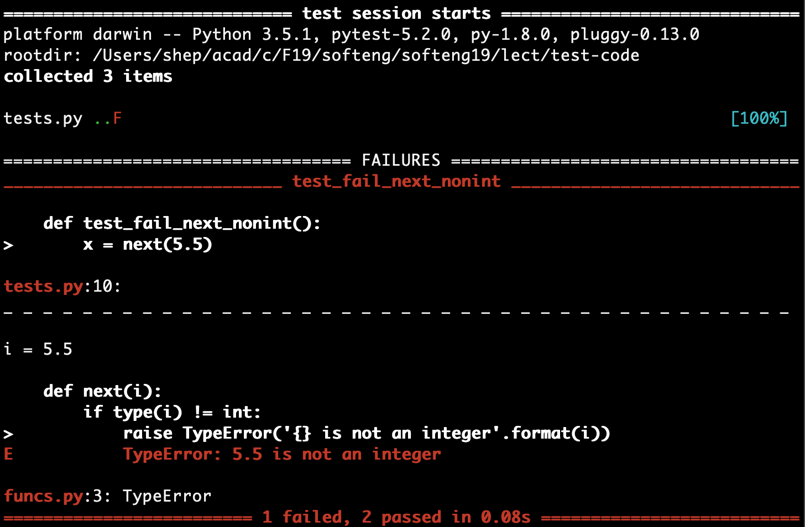
pytest tests.py

Slide 15
Testing exceptional conditions
tests.py
from funcs import next, prev
import pytest
def test_next():
assert next(7) == 8
def test_prev():
assert prev(7) == 6
def test_fail_next_nonint():
with pytest.raise(TypeError):
x = next(5.5)

Slide 16
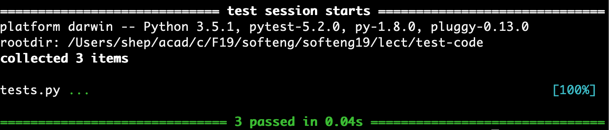
pytest tests.py

Slide 17
Unit test principles
Independent
Should be truly unit, not integration
The results of one test should not affect the results of another
Easy to write
Readable
Reliable
Should only test part of system being tested
Should pass regardless of environment (can’t pass on dev put fail on prod)
Fast

Slide 18
Independent and reliable tests
Each test is independent
Each test should run in a clean environment
We can create clean environments through…
“Mock” objects
Test fixtures

Slide 19
Fixtures
@pytest.fixture(scope="function")
def db():
db1 = DB('dbfile.db')
db1.init()
yield db1
db1.drop()
def test_insert(db):
insert_rows(db)
def test_fail_delete_empty(db):
with pytest.raises(NoDataException):
delete_rows(db)
Each call to a test_* function gets a new, empty DB.

Slide 20
Where to put tests?
Currently, tests are mixed with program code.
Separate using modules.
tests dir (with blank __init__.py file)
funcs dir (with blank __init__.py file and __main__.py file)
“funcs” can be whatever the name of your app is
Run main program
python -m funcs
Run tests
pytest tests

Slide 21
Project Management command line app
Features
Design classes to implement features using StarUML
Clean interfaces will make it easier to test our code
This forms the basis for Assignment A4
Starting point is https://github.com/jbshep/softeng19-a4
pmgr show proj1
pmgr add proj1 task1
pmgr remove proj1 task1

Slide 22
